Slide 1
HISTORY AND EVOLUTION OF FIRST GENERATONS TECHNOLOGIES
CONTENTS :
INTRODUCTION
SANGERS DIDEOXY SEQUENCING
MAXAMGILBERT SEQUENCING
TECHNOLOGIES USED IN HUMAN GENOME PROJECT
ADVANTAGES AND DISADVANTAGES OF FIRST GENERATIONS TECHNOLOGIES

Slide 2
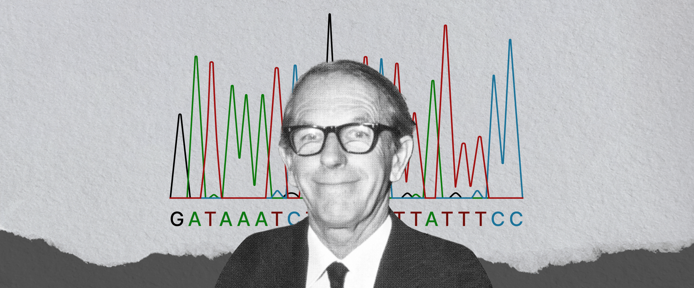
Born-13 August 1918, Died-19 November 2013

Slide 3
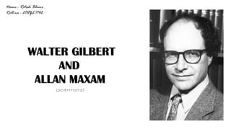
MAXAM GILBERT SEQUENCING METHOD
It is a method by which the sequence of a DNA fragment is identified by using the chemicals, that cut the DNA at specific points.
Also called chemical degradation method of DNA sequencing
■ Develop by Allan Maxam and Walter Gilbert in 1976 to 1977
Walter Gilbert (1932-)

Slide 4
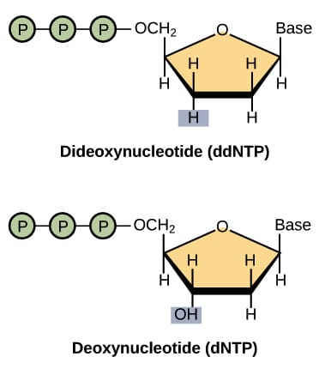
PRINCIPLE
Dideoxy nucleotides are similar to regular, or deoxy, nucleotides, but with one key difference: they lack a hydroxyl group on the 3' carbon of the sugar ring. In a regular nucleotide, the 3' hydroxyl group acts as a "hook," allowing a new nucleotide to be added to an existing chain.

Slide 5
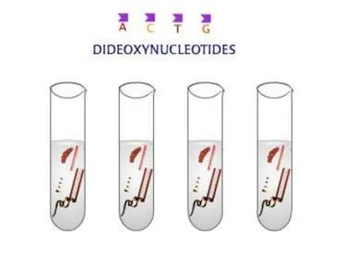
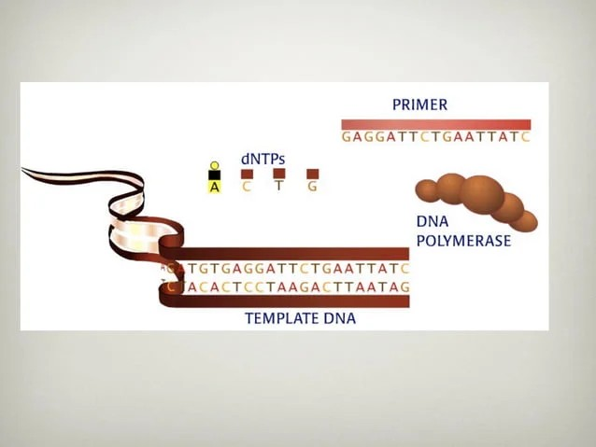
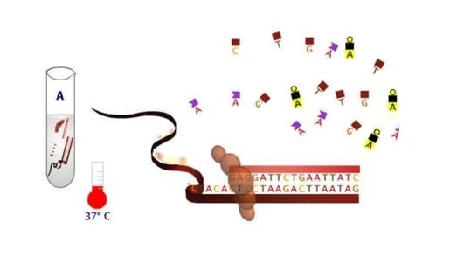
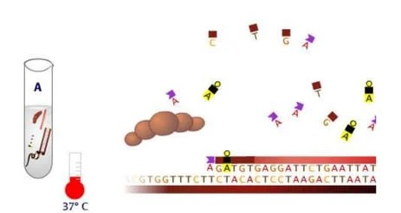
Sanger Sequencing Method

Slide 6
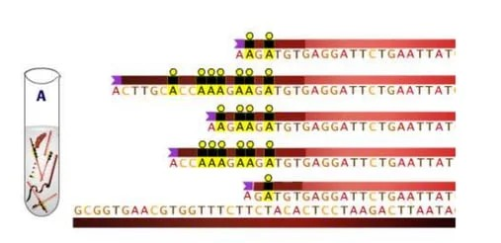
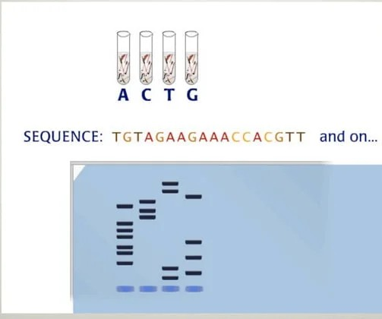

Slide 7
SANGERS DIDEOXY SEQUENCING
Research Purposes: Sanger sequencing is widely used for research applications such as targeting smaller genomic regions in a larger number of samples, sequencing variable regions, validating results from next-generation sequencing studies, verifying plasmid sequences, inserts, mutations, HLA typing, genotyping microsatellite markers, and identifying single disease-causing genetic variants.
Small-Scale Sequencing Projects: Sanger sequencing excels in small-scale sequencing applications like single-gene studies, routine sequencing for cloning and genotyping, and specialized custom projects due to its high accuracy, lower cost, and faster turnaround compared to next-generation sequencing methods.
Filling Gaps in Next-Generation Sequencing Data: Sanger sequencing complements next-generation sequencing by filling gaps in difficult-to-sequence areas and regions with low coverage depth, providing accurate results in critical sections of the genome and validating new NGS approaches.
Mutation Detection: Sanger sequencing is utilized for detecting mutations in DNA, making it valuable in genetic research, diagnostics, and personalized medicine

Slide 8
Maxam-Gilbert Sequencing
Maxam-Gilbert Chemical-Degradation Sequencing
The Maxam-Gilbert sequencing method is a chemical-degradation technique used to sequence double-stranded DNA without the need for in vivo cloning steps.
It involves specific modifications of DNA and subsequent cleavage of the DNA backbone.
This method, developed by Allan Maxam and Walter Gilbert in 1976–1977, was the first widely adopted method for DNA sequencing, alongside the Sanger dideoxy method, representing the first generation of DNA sequencing methods.
However, Maxam-Gilbert sequencing is no longer in widespread use, having been replaced by next-generation sequencing methods due to technical complexity, hazardous chemicals, and difficulties with scale-up

Slide 9
Methods Involved In Maxam Gilbert Sequencing:
Preparation of Sample: The DNA is denatured into single-stranded chains and radiolabeled on the 5′ end.
Cleavage: DNA is cleaved at specific points using chemicals that selectively attack purines and pyrimidines.
Electrophoresis: The cleaved DNA fragments are loaded onto a gel to differentiate fragment sizes and visualized via a radioactive tag.
Reading the Sequence: The sequence is read by interpreting the band pattern relative to the four chemical reactions, determining the nucleotides based on the reaction lanes.

Slide 10
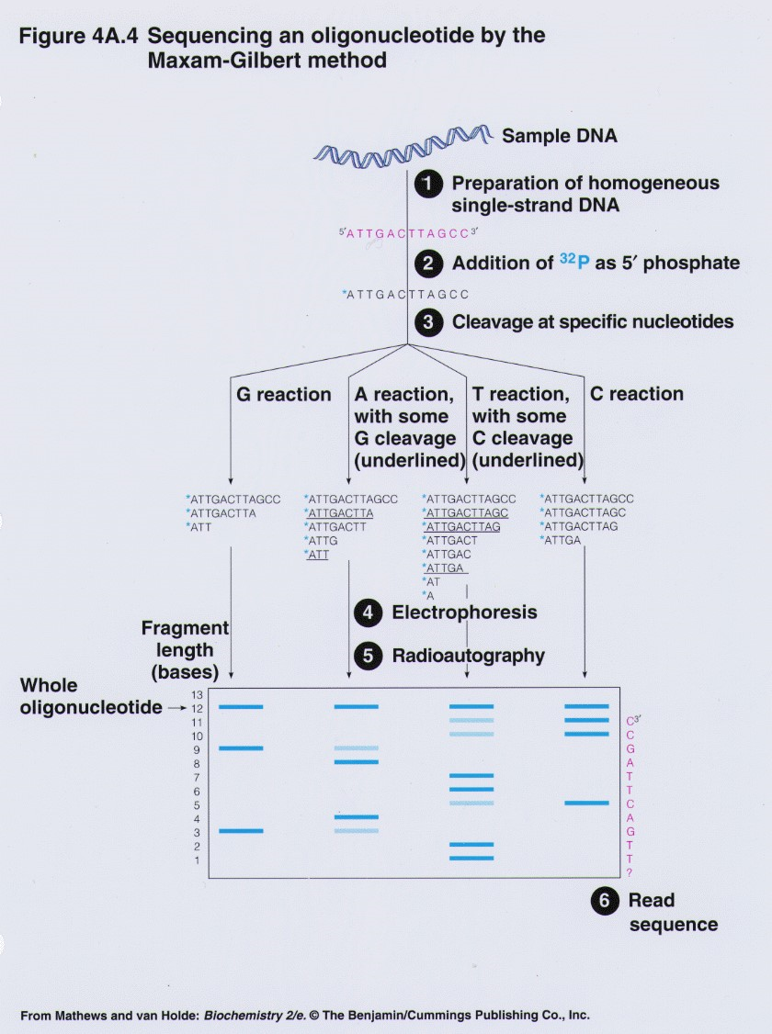
Schematic representation of Maxam Gilbert sequencing method

Slide 11
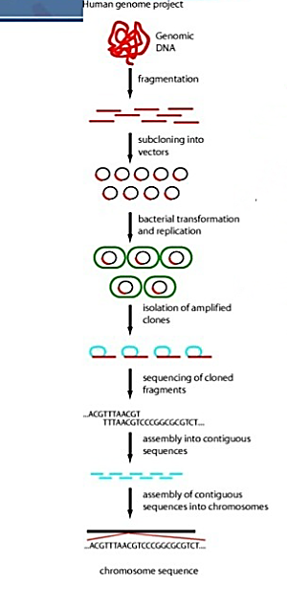
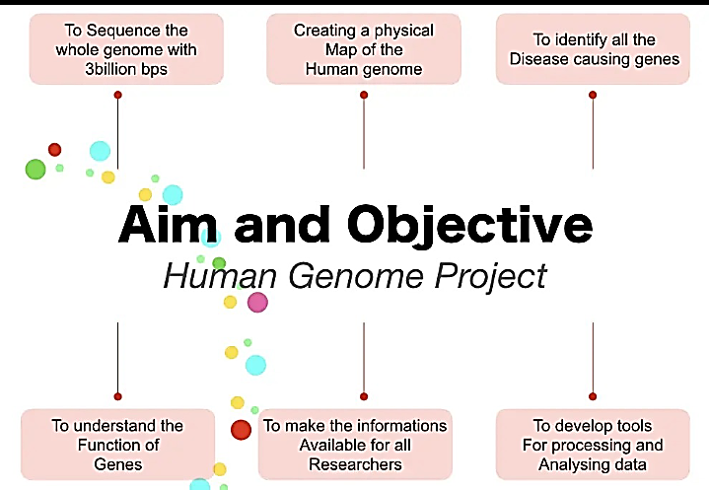
TECHNOLOGIES USED IN HUMAN GENOME PROJECT:
THE HUMAN GENOME PROJECT
The Human Genome Project, completed in 2003, sequenced about 92% of the euchromatin that makes up our genome.

Slide 12
Advantage
Robust and easier to use
First-generation methods boast exceptional accuracy, making them valuable for applications where precise results are crucial.
These methods makes them useful for understanding the fundamentals of DNA sequencing.
In specific situations, like sequencing the mitochondrial genome (which is circular), first-generation methods can be advantageous due to their established protocols.
Disadvantage
Setup is quite complex
Slower
Low Throughput: These methods can only sequence a single fragment at a time, significantly limiting the amount of data generated compared to newer technologies.
High Cost: The process is labor-intensive and requires specialized equipment, making it expensive to sequence large genomes. The Human Genome Project, a massive undertaking, exemplifies this limitation.
Short Read Lengths: First-generation sequencing produces shorter reads compared to newer methods. This can make assembling complete genomes challenging.

Slide 13
LINKS FOR REFERENCES:
Sanger sequencings:
https://youtu.be/dVRB4CaLizc?si=KzNfoin1ExBiXZiI
Maxam gilbert Sequencings:
https://youtu.be/_B5Dj8PL4E0

